Slide 1


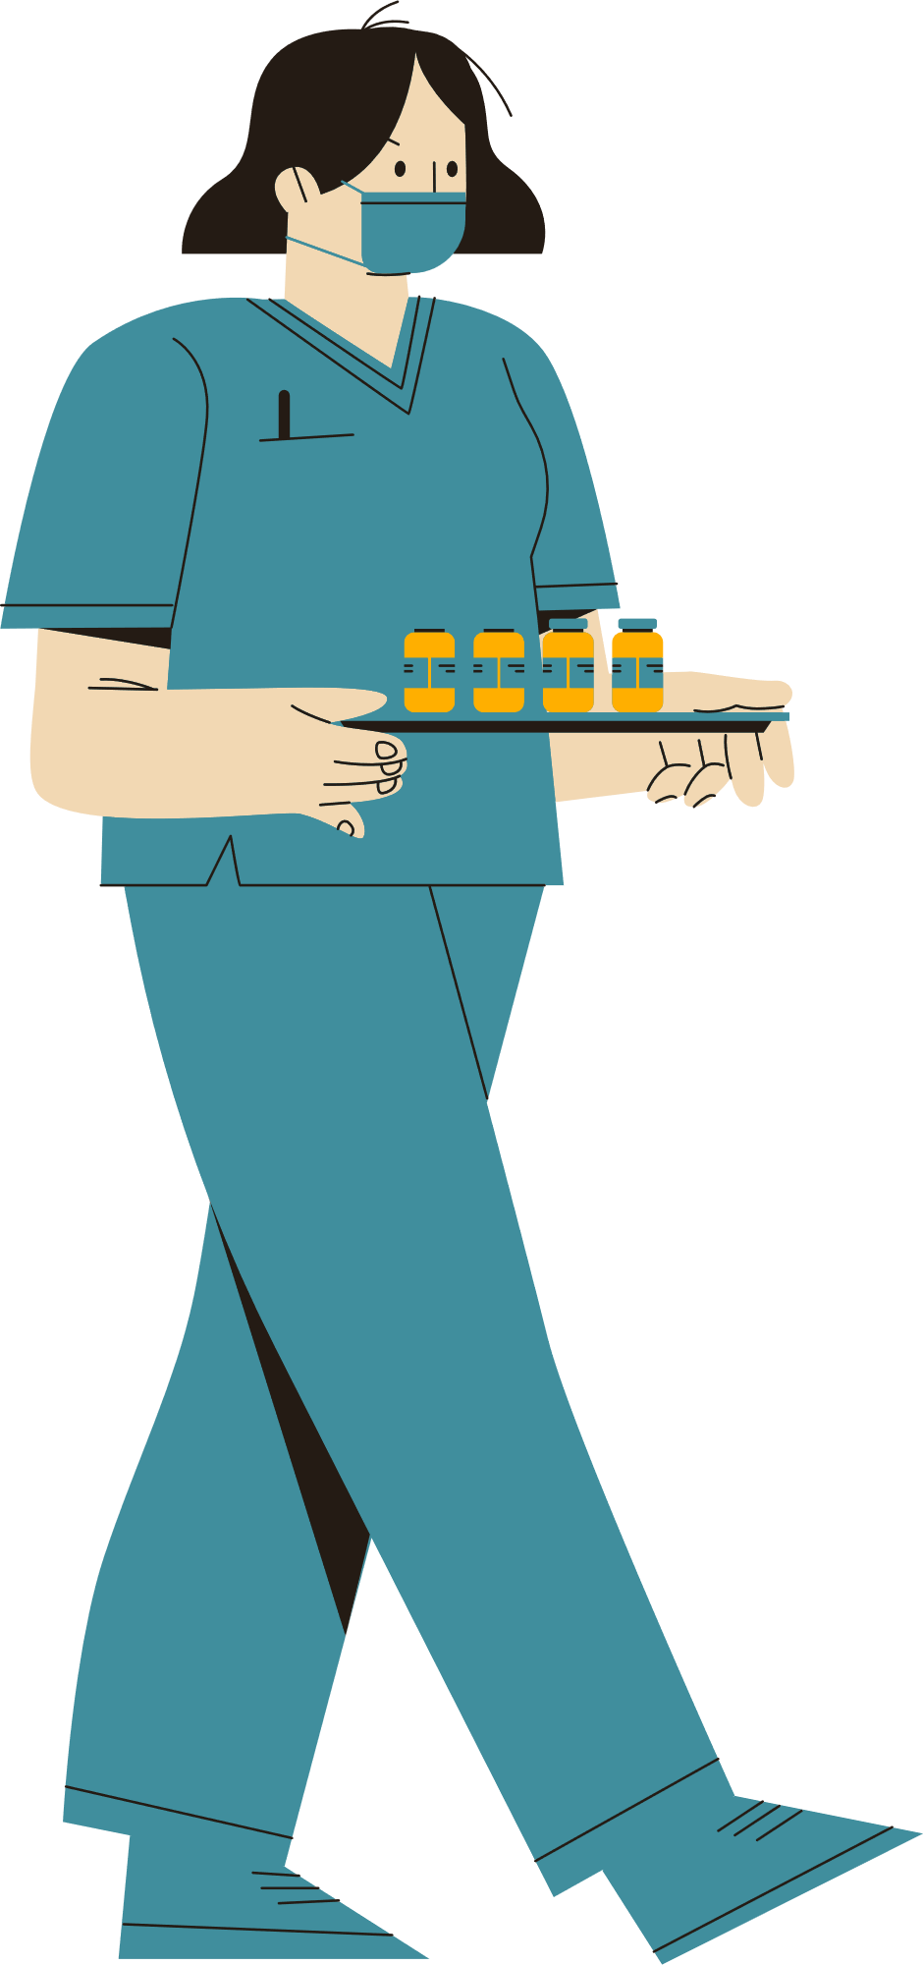

Just Playing Doctor? Shorter Coats Make Young Residents Feel Naked
FCS 327/427
Presented by: Nahid Shabani

Slide 2
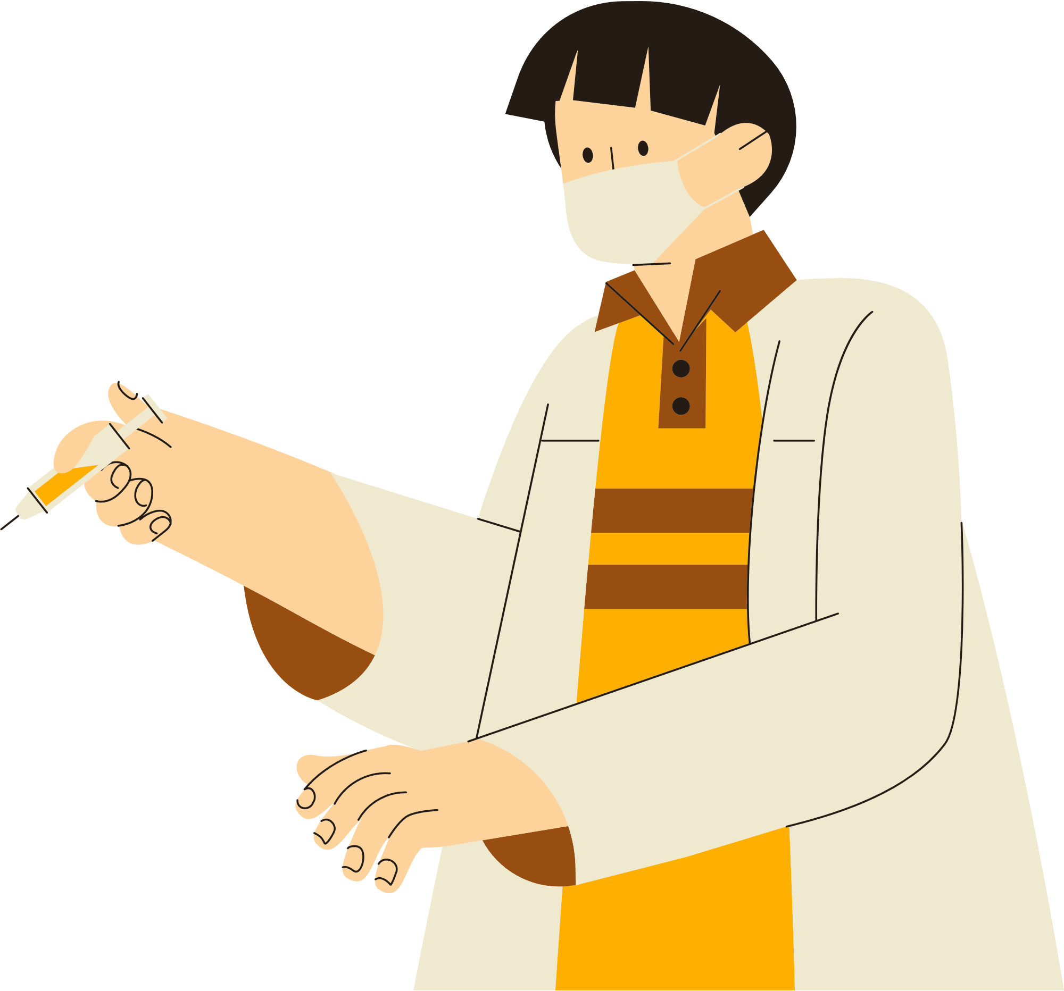

What distinguishes a doctor most? The stethoscope? The fees? Or is it that long, white coat?
White coats aren’t just about status. They protect a doctor's regular clothes, typically shirts, ties, blouses, and such from blood and other stains and germs.
Their deep pockets are handy for carrying prescription pads, stethoscopes, and other small tools.
But during 17th century, length of coat was used to make distinctions. British and American physicians wore long coats, and surgeons short ones.
By the early 20th century, it was common in America for medical residents and interns to wear short white coats, while veteran doctors wear long ones.

Slide 3
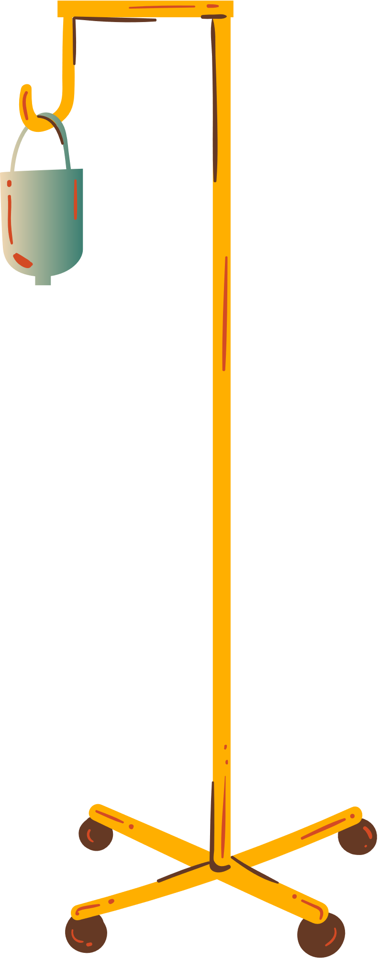
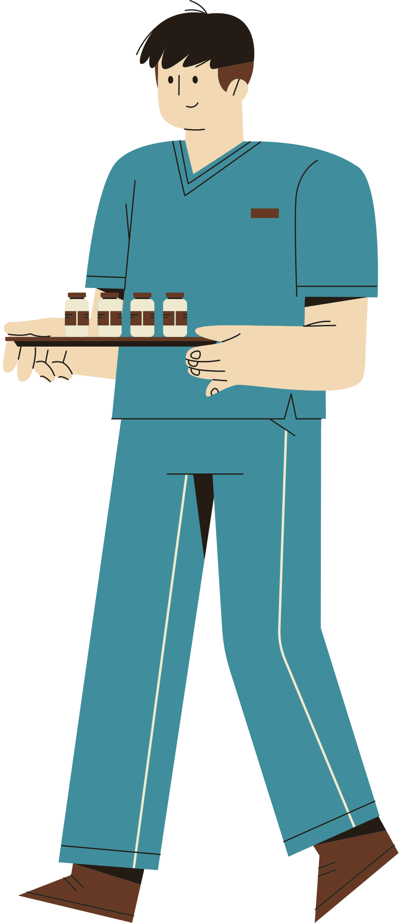
  It's been the controversial question at Duke University Medical Center when a young doctor, Jamy Ard, brought up the question if residents could start wearing long coats.
  The department policy restricted the use of knee-length white coats just to veteran doctors.
  Internal-medicine residents had to wear blazer-length white coats, even though residents in surgery and pediatrics, had recently switched to the longer coats.

Slide 4
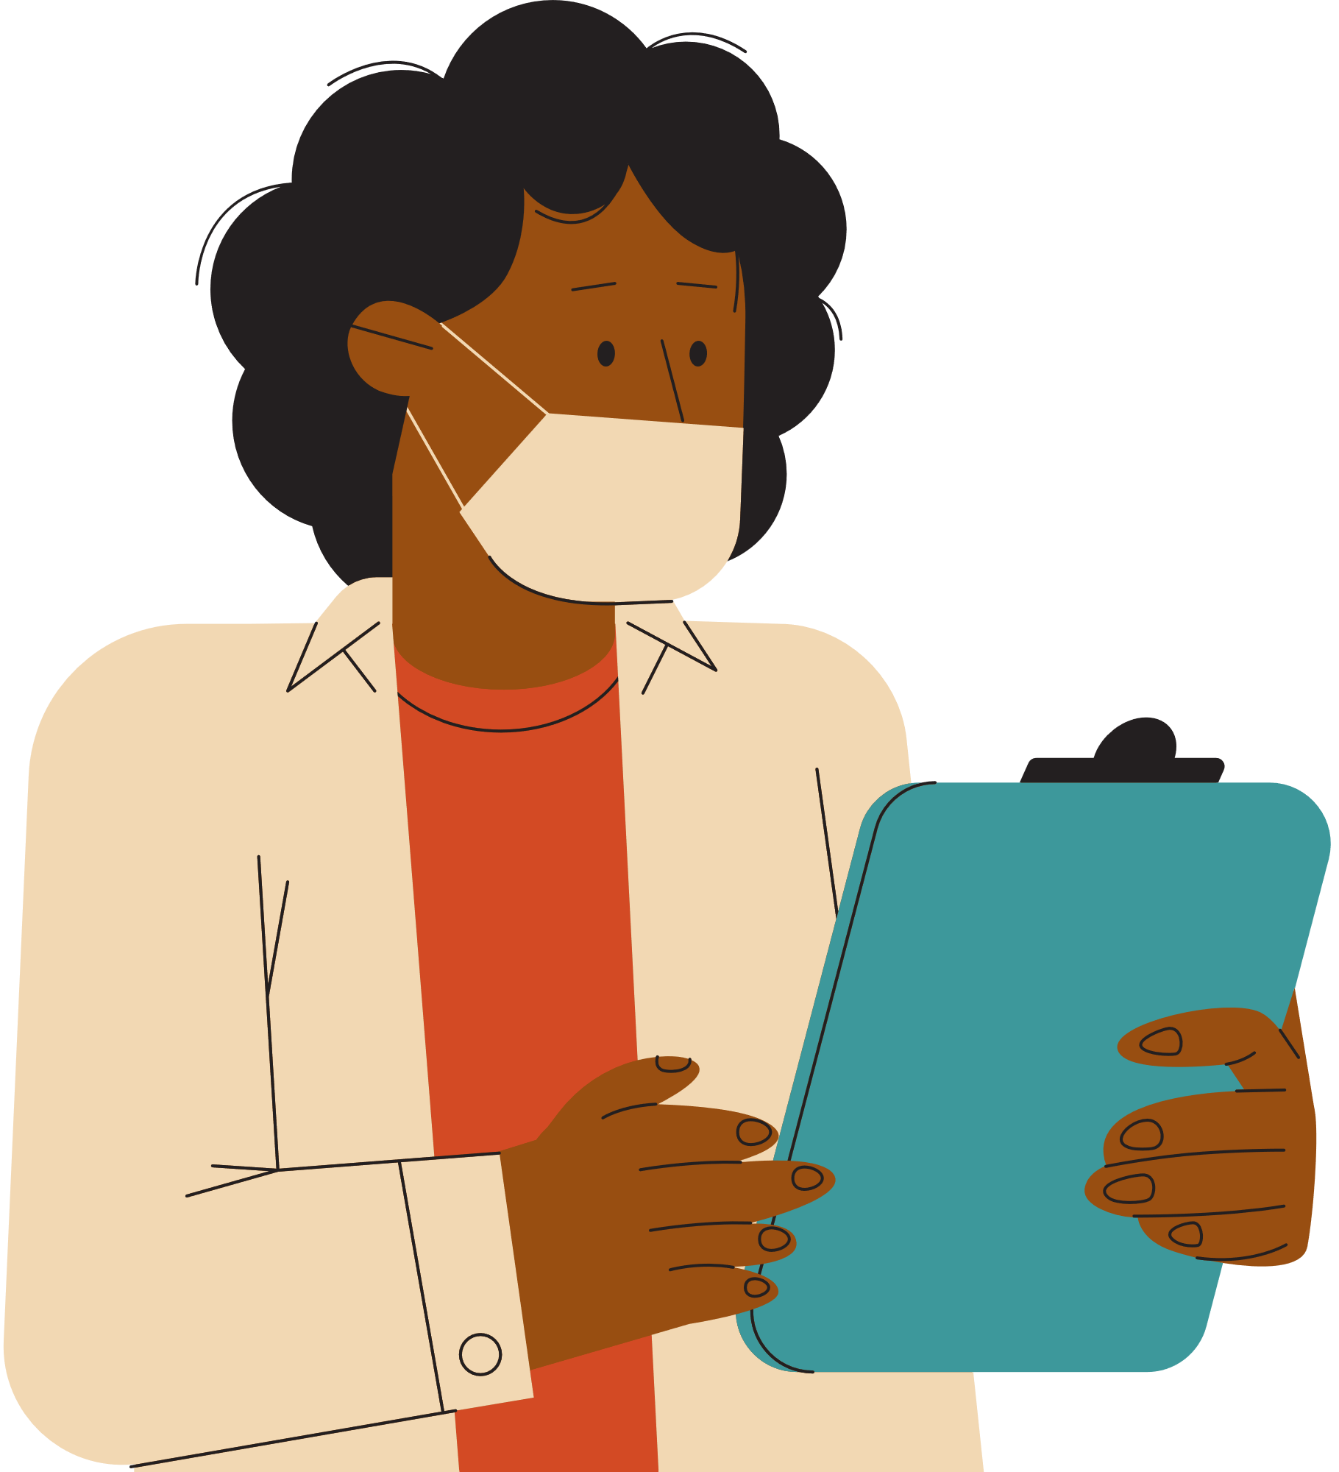
Butcher-Wear
  Nowadays, very few hospitals maintain such sartorial distinctions.
  At Duke, sometimes even managers in environmental services wear long coats. Even though butchers, barbers and cosmetics clerks did to earn them
  In response to Dr. Jamy Ard, any change in coat-length policy, should be considered by the Graduate Medical Education committee, which oversees the residency program and is composed entirely of full-fledged.
  The department suggested Dr. Ard to poll his fellow residents and submit a request to the committee.
  Dr. Ard received substantial support for his campaign to abolish the short-coat rule. about 90 residents responded to Dr. Ard's poll, and a "clear majority" favored dropping the short-coat policy. A minority of residents voted in favor of wearing short coats until their residency is completed.
  Some took emphatic positions, such as third-year walk around in circles and picket
  .

Slide 5
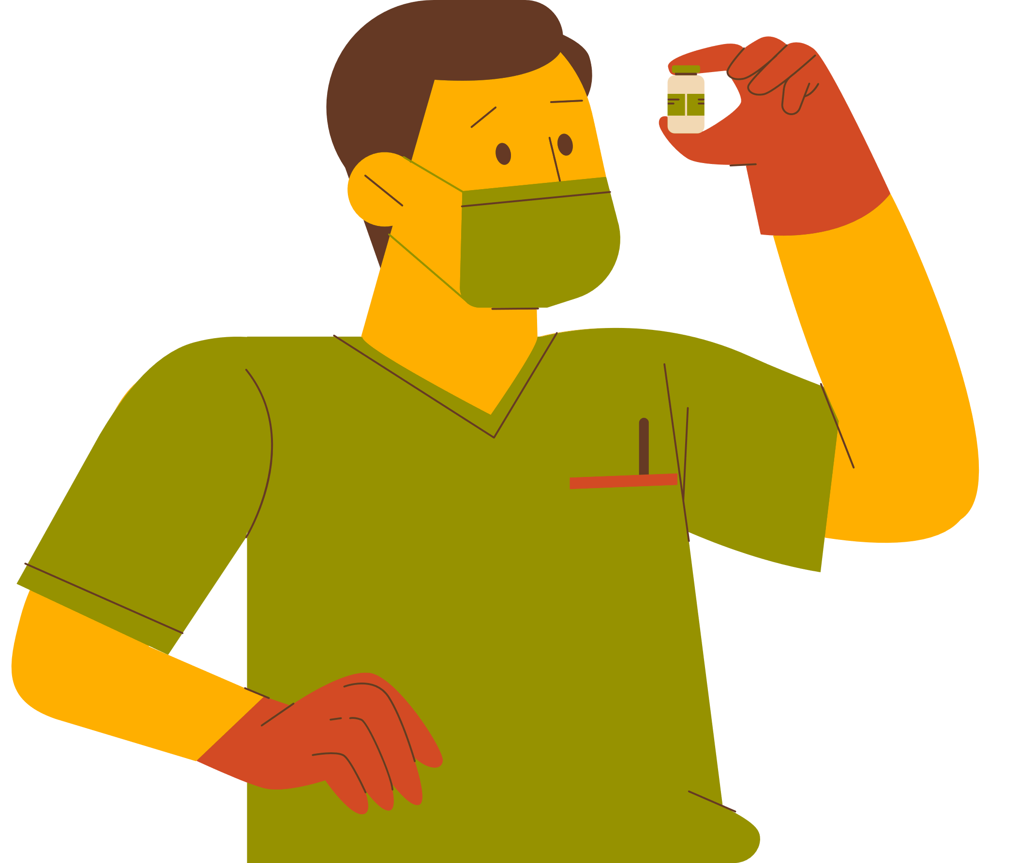
  When first-year resident went to take care of a patient and the woman got a look at her short coat, "she said, 'Are you certain you're a doctor?’ she told her I was, but the patient did not accept it. The resident eventually had to leave the room to find someone in a long coat to tell her I was OK.“
  One resident said that The blazer-length white coat with the white pants that traditionally go with it, makes doctors "look like they're going to serve ice cream,“.
  Short coat opponent warned that the policy could even turn away some residency candidates.
  That argument doesn't impress the Graduate Medical Education committee, they believed if residents are basing a career choice on a hemline, they don't need to be there.
  The vice dean of education for the medical school who experienced going through Duke's residency program about 20 years ago said the long-coat envy seems like adolescent jealousy.
You're a doctor?

Slide 6
Going to Great Lengths
  After receiving Dr. Ard's formal request, the Graduate Medical Education committee finally withdrawn the short-coat requirement.
  The committee warned residents not to let patients think they are veteran physicians and explain the hierarchy of learning.
  The hospital, which typically supplies the coats, already had bought short ones for residents this year. But at least half of the 150 residents went out and bought their own long coats, at about $30 each.
  Some residents said one foot of fabric can make an amazing difference.

Slide 7
Self-Esteem Issues
  Interestingly, those residents "who didn't have any concern about their self-image didn't seem to change to a long coat.
  In repealing the short-coat policy, the committee announced the Knee-length coats remain off-limits to first-year residents. Means that the battle isn't necessarily over.
  This policy, which many other hospitals also follow, doesn't sit well with some interns. Some claimed the long coats are more comfortable, they're more slimming, and they command more respect.
  The new policy bothers even some senior residents. They think it kind of puts the interns down. As a sign of solidarity with interns, some continue to wear a short coat.

Slide 8
Questions:
Residents boast medical degrees. They work longer hours and spend more time with patients than do veteran physicians. Why should residents wear a coat that causes some patients to mistake them for students or nurses?
Why do you think while butchers, barbers, and cosmetic counter employees can wear long white coats, can't those who have recently earned a medical degree wear one?
What do you think was the reason that this policy set only to residents?
Imagine that you were a doctor, would you like to this policy being imposed on you? Why on Why not?
Imagine that you are visiting a resident wearing long coat. Can you completely trust that person to take care of you?

Slide 9
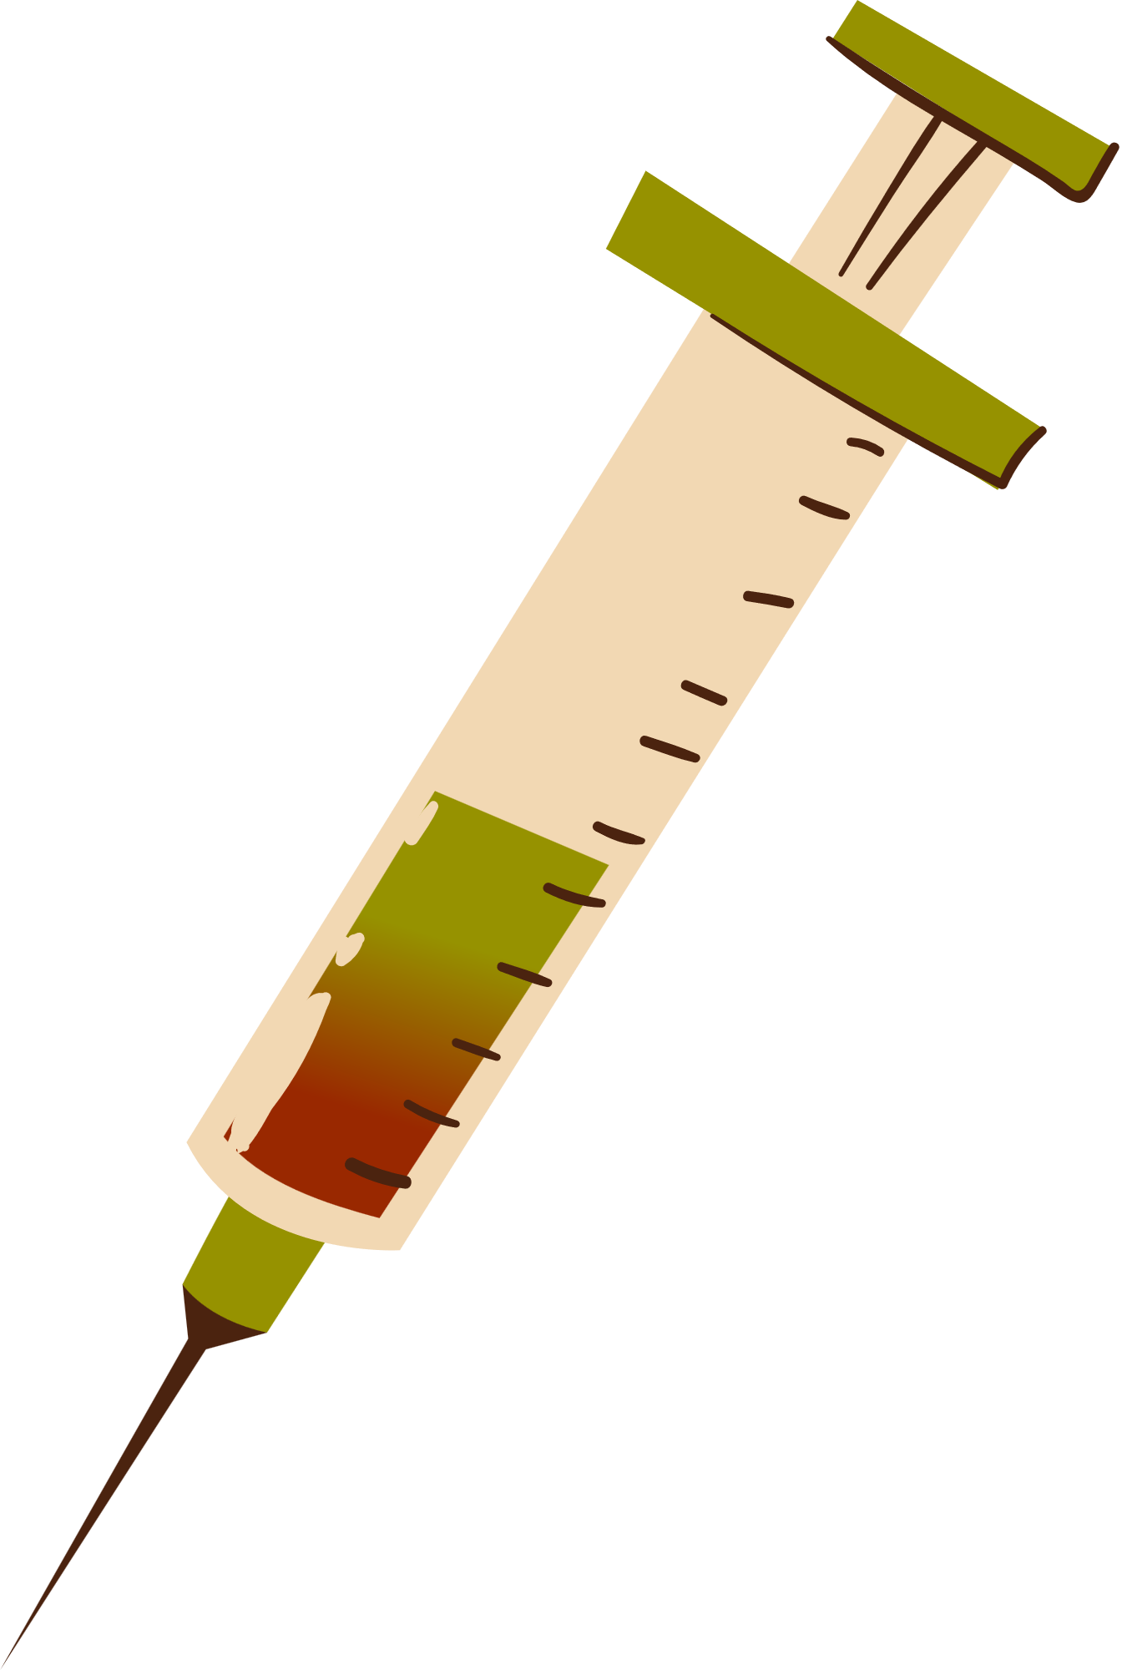

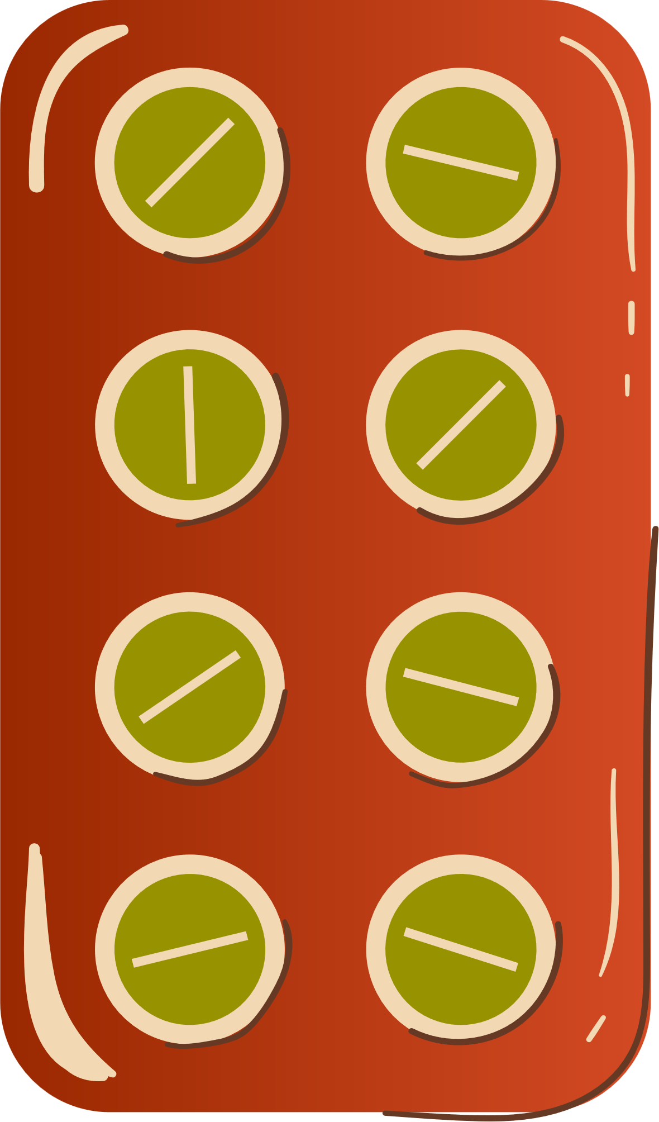







References:
COLEMAN, C. Y. (2000, FEBRUARY 2). JUST PLAYING DOCTOR? SHORTER COATS MAKE YOUNG RESIDENTS FEEL NAKED. THE WALL STREET JOURNAL. RETRIEVED FROM https://www.wsj.com/articles/SB949453761364445605

