Slide 1
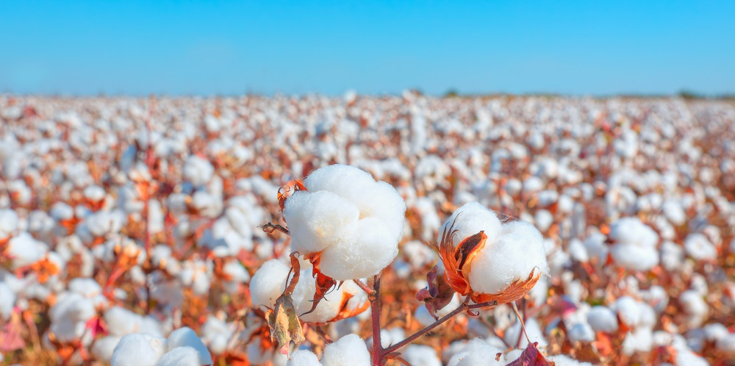
TOUGH COTTON™ Technology
FCS 471/ NAHID SHABANI
Date of Submission: May 2nd, 5 pm

Slide 2
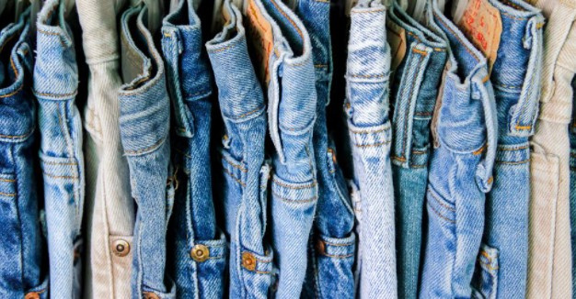
The first impression matters.
The brand speaks up its uniqueness of breathability
and comfort through
the remarkable Technology.
NAHID SHABANI

Slide 3
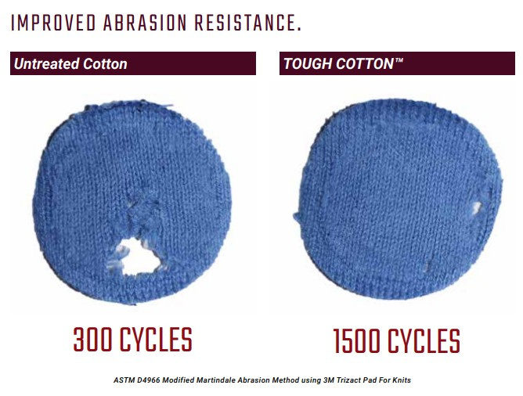
TOUGH COTTON™
Consumers already know cotton for its quality and durability and that’s nothing new. Now, the long-lasting comfort of cotton is even better. Cotton can withstand even the toughest challenges—falls on the playground or climbing the trail.
Through everyday use and home laundering, fabrics can become abraded, causing cotton fibers to rise to the surface, weakening the fabric, and making the appearance look faded. With TOUGH COTTON™ technology, you don’t need to worry about poor performance. Yarns, fabrics, and garments treated with TOUGH COTTON™ technology offer enhanced durability—a combination of abrasion resistance, strength, and colorfastness
TOUGH COTTON™ technology brings increased durability, superior abrasion, and wrinkle resistance throughout the life of the garment. So, with getting TOUGH there is no fear of less wear to prevent tear.

Slide 4
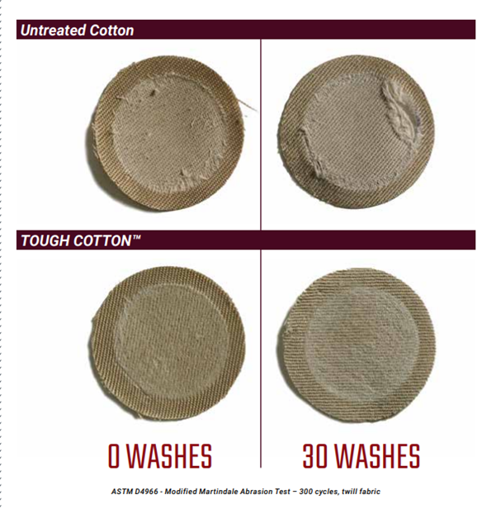
Tough Cotton Technology
Cotton is an important raw material for producing soft textiles and clothing. Recent discoveries in functionalizing cotton fibers with nanotubes offer a new line of tough, wearable, smart and interactive garments:
•Improves Durability and lasts the life of the garment
•Designed to handle various functions
•Increase strength with proprietary, dual process treatment
•Available in resin and non-resin formulas
• Improves strength, durability and abrasion resistance
• Improves wrinkle resistance with a durable press option
• Maintains the natural comfort and breathability of cotton
• Available as a yarn, fabric or garment finish
• Applicable on knit and woven fabrics
• Maximum design flexibility without sacrificing performance

Slide 5

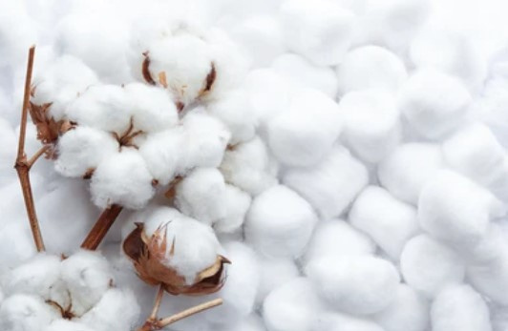
Cotton Trends
Cotton is already known for its quality and durability. Over time, regular wearing and washing can wear down fabrics, causing cotton fibers to rise to the surface, weakening the fabric and making the appearance look faded.
So, the need for having toughest challenge resistant cotton products is emerging.
Outdoor Wear: Quality and Durability for wearer are extremely important when it comes to workwear or outdoor activity:
01
Outerwear & Jackets
02
Knit & Woven Bottoms
03
Workwear & Uniforms
04
Tailored Apparel
05
Childrenswear
06
Denim
07
Canvas Accessories
08
Yoga & Activewear
09
Sweaters & Socks

Slide 6
Lifestyle Trends That Influence The Consumption Of Cotton Brands
1
2
3
4
Quality
Durability
Resistance
Wash Safe:
80% of parents feel that durability and quality play an important role in purchasing decisions for children’s clothing.
U.S. shoppers say knowledge about the use of natural fibers (57 percent) and “more sustainable production” (59 percent) would impact their purchase of denim jeans, according to the Global Denim Study.
58% believe that “good quality” means durable or long-lasting, 23% believe it means good or strong fibers and materials, and 12% believe the garment was made well.
Variety of product categories, from workwear to tailored apparel need an applied cotton technology through yarn enhancement to increase the strength and colorfastness of high-friction areas such as the heel and toe of a sock or the elbows of a sweater to be targeted to last longer and stay stronger.
Consumers need durable clothing with no fear of holes or tears in that well-loved yoga sweater. Reliable cotton that will not tear or rip or not fade or wear out when washed and dried is crucial to consumers.

Slide 7

Durable Technology for Cotton Offers Superior Performance by :
Improving strength, durability, and abrasion resistance
Improving wrinkle resistance with a durable press option
Maintaining the natural comfort and breathability of cotton
Applicable on knit and woven fabrics
Lasting the life of the garment

Slide 8
S
W
O
T
Strengths
Weaknesses
Opportunities
Threats
  up to 8 times improved abrasion resistance
  wrinkle resistance
  quality and durability
  Applicable on knit and woven fabrics
  comfortable and breathable
  ability to blend with resin
  does not irritate the skin
  Brand Awareness
  Customers trust
  New to market
  No supportive informtion
  improve fabric hand and sewability
  Potentiality to capitalize on the work lifestyle trend
  Can be combined with STORM COTTON™ & TOUGH COTTON™ Finishes to improve performance
  The use of resin in coating is not environmentally friendly
  Price volatility due to availability of suppliers in other countries
  Environmental conditions could affect the natural growing season and hinder production of cotton products
  Use of pesticides in farming acts against the growing organic lifestyle trend

Slide 9


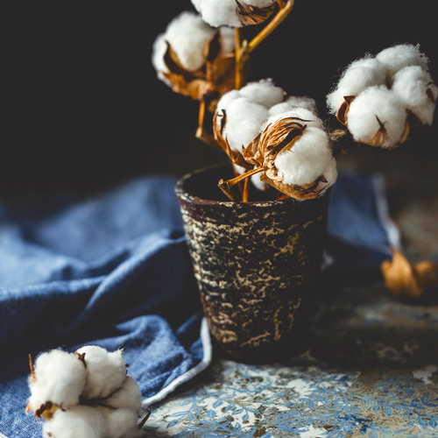
LINE PLANNING
Categories of merchandise:
Denim wear
Price:
Moderate to High
Quality:
premium
TYPE OF CUSTOMER SERVICE:
Prime service

Slide 10




LINE PLANNING
High-end adult consumers looking for a must have items for their closet and caring for quality, fit, and comfort living in metro cities, spending time in office or coffee shop to work and eager to spend money on minimal goods to look neat and classy.
AGE
Young Adult Women (Early 20's to Late 40's)
BUYING BEHAVIOUR
From category of consumer who thoughtfully evaluate the long-term benefits of purchase before placing the order
INCOME
$40,000 and above
LIFE-STYLE CHARACTRISTICS
EDUCATION
Fast paced lifestyle, mostly working in business and science field. spending most of their time outdoor.
College educated

Slide 11
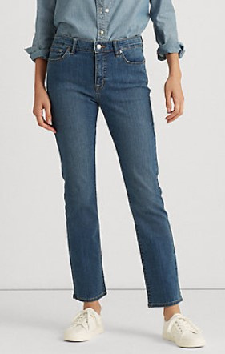
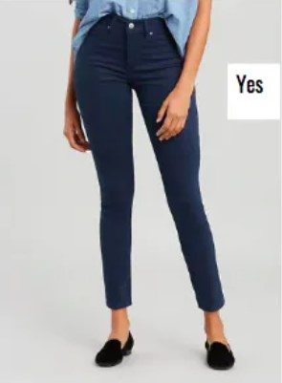
Business Casual Jeans
Description of style: Business Casual Jeans, designed for wearing for long hours with the focus on comfort and quality, which has functional features such as wrinkle resistance, No- stretch to keep shape retention, breathable, fine touch and not irritating the skin.
Jeans were among the first clothing items to rebound after 2020.
Color options: 7 colors
Indigo Black (002e51)
Indigo Dye (00416c)
Traditional Denim (7f97b5)
Light Denim (b8cad5)
British Khaki (bcaf97)
White Ice (f1eeeb)
Pale Grey (fdfdfe)
Size options: 4, 6, 8, 10, 12, 14, 16
Fabrication
Main Jeans layer: 98% TOUGH COTTON™, 2% Spandex
Pocket lining: 100% Cotton
Price line: $159.00

Slide 12
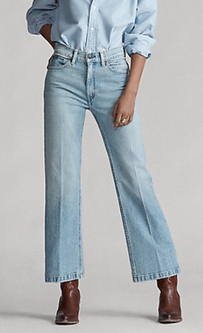
Straight Fit Ankle Jeans
Description of style: Straight Fit Ankle Jeans, designed for wearing for long hours with the focus on comfort and quality, which has functional features such as wrinkle resistance, No- stretch to keep shape retention, breathable, fine touch and not irritating the skin.
Color options: 7 colors
Indigo Black (002e51)
Indigo Dye (00416c)
Traditional Denim (7f97b5)
Light Denim (b8cad5)
British Khaki (bcaf97)
White Ice (f1eeeb)
Pale Grey (fdfdfe)
Size options: 4, 6, 8, 10, 12, 14, 16
Fabrication
Main Jeans layer: 98% TOUGH COTTON™, 2% Spandex
Pocket lining: 100% Cotton
Price line: $129.00

Slide 13

Denim Jacket
  Description of style: The classic denim jacket is the one that never goes out of style. It is coated with tough cotton technology. This gets well with any wear and perfect for layering in each seasons. It focuses on comfort along with quality, which has functional features such as Button front, Front and chest pockets, Slim fit, Long sleeves, and Above-hip length.
  It features wrinkle resistance, No- stretch to keep shape retention, breathable, fine touch and not irritating the skin.
Color options: 7 colors
Indigo Black (002e51)
Indigo Dye (00416c)
Traditional Denim (7f97b5)
Light Denim (b8cad5)
British Khaki (bcaf97)
White Ice (f1eeeb)
Pale Grey (fdfdfe)
Size options: 4, 6, 8, 10, 12, 14, 16
Fabrication
Main Jacket layer: 98% TOUGH COTTON™, 2% Spandex
Pocket lining: 100% Cotton
Price line: $169.00
Photo is taken from BananaRepublic.com

Slide 14
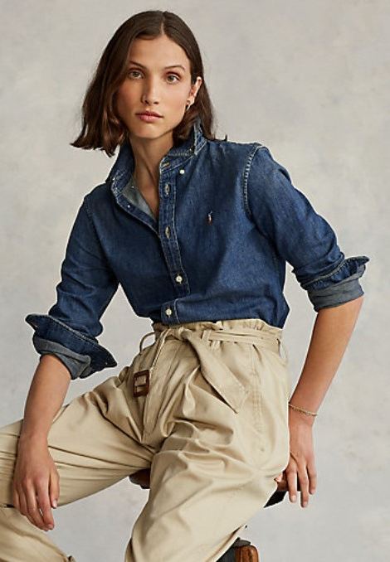
Custom Fit Denim Shirt
  Description of style: The classic shirt is a timeless go-to that coated with tough cotton technology. This Custom Fit gets well with any wear and perfect for layering in each seasons. It focuses on comfort along with quality, which has functional features such as no-stretch trim silhouette, Long sleeves with buttoned barrel cuffs, Button-down point collar, and Buttoned placket.
  It features wrinkle resistance, No- stretch to keep shape retention, breathable, fine touch and not irritating the skin.
Color options: 7 colors
Indigo Black (002e51)
Indigo Dye (00416c)
Traditional Denim (7f97b5)
Light Denim (b8cad5)
British Khaki (bcaf97)
White Ice (f1eeeb)
Pale Grey (fdfdfe)
Size options: 4, 6, 8, 10, 12, 14, 16
Fabrication
Main Shirt layer: 98% TOUGH COTTON™, 2% Spandex
Price line: $149.00
Photo of key merchandise is taken from Raulphlauren.com

Slide 15
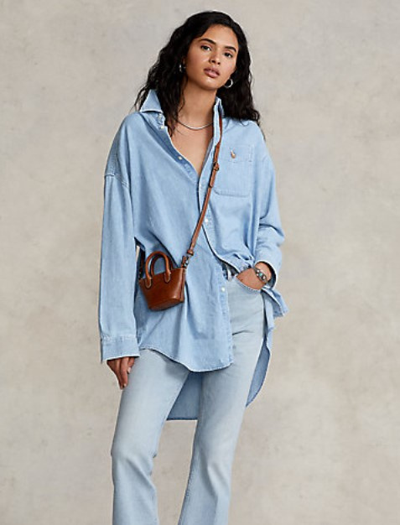
Oversized Denim Shirt
  Description of style: The classic shirt that is coated with tough cotton technology. This oversized shirt creates the timeworn character and soft drape. It gets well with any wear and also perfect for layering in each seasons. It focuses on comfort along with quality, which has functional features such as Long sleeves with buttoned barrel cuffs, Point collar. Buttoned placket.
  It features wrinkle resistance, No- stretch to keep shape retention, breathable, fine touch and not irritating the skin.
Color options: 7 colors
Indigo Black (002e51)
Indigo Dye (00416c)
Traditional Denim (7f97b5)
Light Denim (b8cad5)
British Khaki (bcaf97)
White Ice (f1eeeb)
Pale Grey (fdfdfe)
Size options: 4, 6, 8, 10, 12, 14, 16
Fabrication
Main Shirt layer: 98% TOUGH COTTON™, 2% Spandex
Price line: $139.00
Photo of key merchandise is from Raulphlauren.com

Slide 16
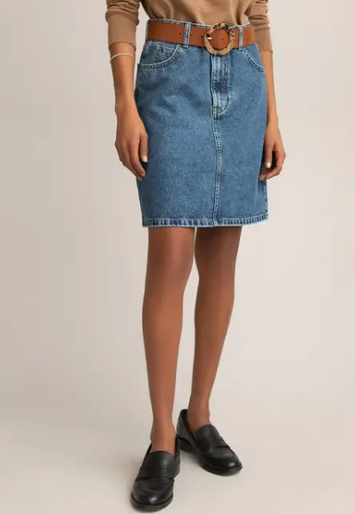
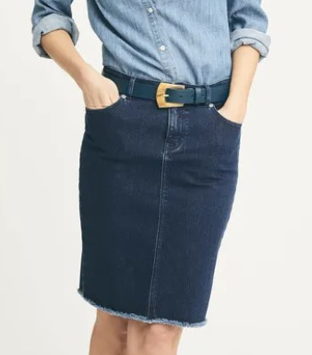
Denim Skirt
  Description of style: The classic must have skirt coming back from nineties trends, coated with tough cotton technology and is a timeworn character. It gets well with even sandals or boots, and also perfect for wearing in each seasons. It focuses on comfort along with quality, which has functional features such as High rise, Front zip closure with single button, 5-pocket styling, Folded hemline.
  It features wrinkle resistance, No- stretch to keep shape retention, breathable, fine touch and not irritating the skin.
Color options: 7 colors
Indigo Black (002e51)
Indigo Dye (00416c)
Traditional Denim (7f97b5)
Light Denim (b8cad5)
British Khaki (bcaf97)
White Ice (f1eeeb)
Pale Grey (fdfdfe)
Size options: 4, 6, 8, 10, 12, 14, 16
Fabrication
Main Skirt layer: 99% TOUGH COTTON™, 1% Spandex
Pocket: 92% Cotton, 8% Polyester
Price line: $119.00
Photo of key merchandise is from LaRedoute.co.uk and jmclaughlin.com

Slide 17
Marketing Strategies to Successfully Initiate New Cotton Markets
PRICING STRATEGY:
For the high value product presented, a combination of High/Low and Prestige Pricing Strategies would be reflected with the plan of being marked down on special occasion.
BRANDING AND ADVERTISING STRATEGIES:
Planning to promote through sustainable practice campaigns and with bumper ads and on social media platforms. By doing this quickly reach viewers broadly with a short, memorable message.
As well as going one step further to inform customers about the company products characteristics and get them interested to surf the product lines and involve them to place the purchase.
CUSTOMER ACQUISITION AND RETENTION STRATEGIES:
A loyalty program of offering 15% off on sign up for newsletter and first purchase
A beneficial point system of offering 1 point per $1 spent to get 30% on each 200 points
As an incentive making target customers aware of revolutionary specifications for purchasing must-have products with at full price
Engagements with social media influencers and celebrities in marketing campaigns
To keep up true with the values behind being sustainable and ethical in production processes with detailed marketing
Keeping the record of customer interaction with the website and stay in touch with following up their actions.
Being committed to maintain high quality performing products at a reasonable price in comparison to competitors through the Wear Test Program
Remain transparent in marketing information about Tough-Cotton technology products

Slide 18

Photo from https://www.amvac.com/
MARKETING PLAN TIMELINE
Month 2
Month 4
Loyalty program and point system continued.
Engagement with one influencer
Sustainability awareness campaign continued in February
Updating website weekly
Evaluating to add new products to stores
Loyalty program and point system continued.
Engagement with one celebrity and one blogger
Sustainability awareness campaign continued in April
Marketing events at store-level
Virtual Wear Test continued
Update website on weekly basis
Adding more products to stores and website
1
2
3
4
5
Month 1
Month 3
Month 5 and so forth
Loyalty program and point system creation.
One Blogger engagement.
Sustainability awareness campaign in January
Update website on weekly basis
Update products in stores
Loyalty program and point system continued.
Engagement with one celebrity.
Promoting sustainability awareness campaign and discount on Earth day in March.
Update website on weekly basis
Adding more products to stores and website
Virtual Wear Test launch in March
Loyalty program and point system continued.
Engagement with one celebrity and one blogger
Sustainability awareness campaign continued in May.
Promote Mother’s Day gift wrapping
Increase marketing events at store-level.
Wear Test Program continued.
Update website on weekly basis

Slide 19
Strategies for Consumer Experiences and Service
Strategies for customer experiences and services that speak to the cotton branded products:
  Broadcast interesting contents on social media platform on a regular basis to target more customers.
  Create the Wear Test Program to entice customers to become the brand ambassador
  Enable each customer to review products that other customers use in the purchase making decision.
Strategies for online (and offline) shopping environments:
  Make the online store website's user friendly for searching features, product navigation, and checkout.
  Exhibit merchandises with 360-degree view, high-resolution photos, video, and zoom in and out feature that perfectly fits to customer screen.
  Provide customer reviews on product pages about fits and features on the online website .
  Provide easy to shop omni-channel shopping experiences across company shopping channels.
  Offer different payment methods through Apple Pay, Karla, Debit/Credit card, or PayPal
Strategies for customer service:
Since Customer Experience is the key to success in buying trends:
Create a 24/7 contact page that makes it seamless how to contact with real customer service (not AI feature).
Use analytics tools such as open-source Google Analytics tools to gain further reports on how customers find the new Cotton products
Marketing efforts on the shopping channels that consumers use
Offer free shipping
Offering similar items that customers looking for
Keep the connection with customers via email marketing tools like Mailcamp

Slide 20
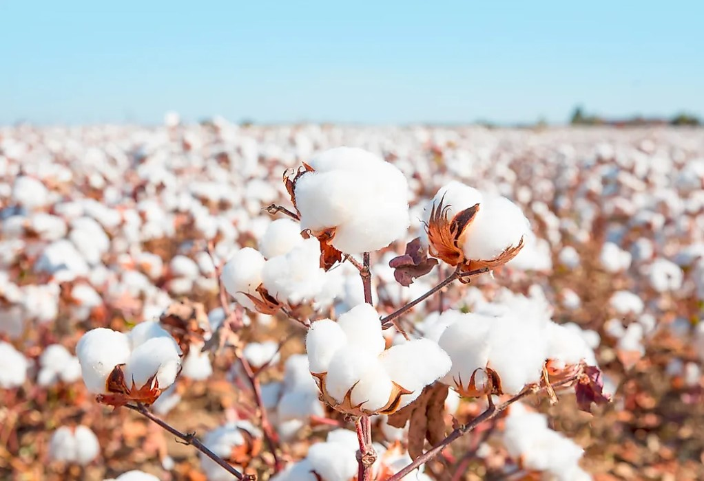
Month | Week | Event | Sales and Promotion Strategies
February | 1
 | 2 | Valentine’s Day | Buy one Get one 50% off
 | 3 | Presidents Day
 | 4
March | 5
 | 6
 | 7 | St. Patrick’s Day
 | 8 | Spring Begins | Double Points for Loyalty Reward Members
 | 9
April | 10 | Easter Sunday | Buy one Get one 50% off
 | 11
 | 12 | Earth Day | Buy one get one free
 | 13
May | 14
 | 15 | Mother’s Day | Mother’s Day Shopping Event/Free Gift Wrapping
 | 16
 | 17 | Memorial Day | Double points for Loyalty Reward Members
June | 18 | Graduation Season | Buy one Get one 50% off
 | 19
 | 20 | Father’s Day
 | 21 | Summer Begins
 | 22
July | 23 | Independence Day | Semi-annual sale preview for loyalty reward members
 | 24 |  | Semi-annual sale
 | 25 |  | Semi-annual sale
 | 26 |  | Clearance
Sales and Promotion Strategies
Sales and Promotional Events:
Valentine’s Day
Spring Begins
Easter Sunday
Earth Day
Mother’s day shopping event
Memorial Day
Graduation Day
Independence Day
Monetary Promotions:
Buy one get one 50% off
Buy one get one free
Semi-annual sale preview
Semi-annual sale
Clearance
Loyalty Program:
Offering points for loyalty reward members
Photo from https://www.worldatlas.com/

Slide 21
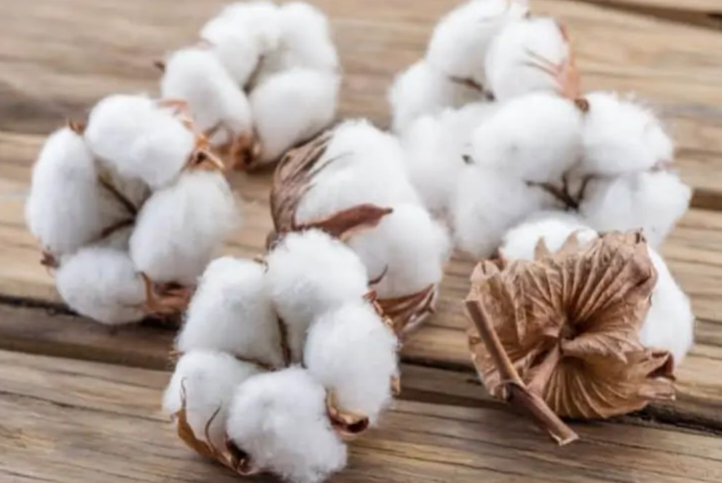
Financial Projection and Plan for Market Growth
Income Statements | First year |  | Second year |  | Third year
 |  |  | 4% increase in Sale |  | 10% increase in sales
Gross Sales | $40,520,000 | 101.3% | $42,224,000 | 101.5% | $57,554,640 | 101.5%
Customer Returns & Allowances | $520,000 | 1.3% | $624,000 | 1.5% | $794,640 | 1.4%
Net Sales | $40,000,000 | 100% | $41,600,000 | 100% | $45,760,000 | 100%
Cost of Goods Sold | $20,000,000 | 50% | $20,800,000 | 50% | $22,880,000 | 50%
Gross Margin | $20,000,000 | 50% | $20,800,000 | 50% | $22,880,000 | 50%
Procurement Costs | $4,000,000 | 10% | $4,160,000 | 10% | $4,576,000 | 10%
Adjusted Gross Margin | $16,000,000 | 40% | $16,640,000 | 40% | $18,304,000 | 40%
Operating Expenses | $12,000,000 | 30% | $12,480,000 | 30% | $13,728,000 | 30%
Operating Profit | $4,000,000 | 10% | $4,160,000 | 10% | $4,576,000 | 10%
Other Income & Expenses | $400,000 | 1% | $416,000 | 1% | $457,600 | 1%
Net Profit before Taxes | $3,600,000 | 9% | $3,744,000 | 9% | $4,118,400 | 9%
Photo from https://www.conserve-energy-future.com/

Slide 22
Conclusion
The plan is to create a full line of Denimwear with premium price (moderate to high) level featuring TOUGH COTTON technology, with the focus on comfort, durability, wrinkle resistance, stretch-free to keep shape retention, breathability, fine touch and not irritation to the skin.
This Business Plan offers incentives to customers, such as discounts, loyalty program, point system, and transparency to keep-in-touch and make them coming back for new collection release.
Financial projection for the second year is 4%, and 10% for the third year.
Photo from https://www.amvac.com/

Slide 23
REFERENCES
Cotton Incorporated. (2022, April 25). Tough cotton™ technology: CottonWorks™. CottonWorks. Retrieved 2022, from https://www.cottonworks.com/en/topics/fabric-technology/performance-technologies/tough-cotton-technology/
Ltd, A. A. (2021, December 31). Market segmentation of Jeans Brand. UK Essays. Retrieved May 1, 2022, from https://www.ukessays.com/essays/marketing/market-segmentation-of-jeans-brand-marketing-essay.php
Anderson, K. (2021, August 31). Cotton: The new generation. AATCC. Retrieved April 30, 2022, from https://aatcc.org/news2021-09a/
Hyde Park Denim Company. (n.d.). Pocketing fabric for sale. Denim Pocketing Fabric Material - USA Wholesale Denim Supplier. Retrieved 2022, from https://www.hydeparkdenim.com/Pocketing-Fabric
Cotton Incorporated. (2022, April 29). Big Opportunities for Denim. Cotton Lifestyle Monitor. Retrieved April 30, 2022, from https://lifestylemonitor.cottoninc.com/big-opportunities-for-denim/
Spacey, J. (2020, August 8). 24 types of denim color. Simplicable. Retrieved 2022, from https://simplicable.com/en/denim-color
Cotton Incorporated. (2021, December 6). Denim in 2022. Cotton Lifestyle Monitor. Retrieved April 30, 2022, from https://lifestylemonitor.cottoninc.com/denim-in-2022/
Avila, A. G., & Hinestroza, J. P. (2008). Tough cotton. Nature Nanotechnology, 3(8), 458–459. https://doi.org/10.1038/nnano.2008.233
Anderson, K. (2021, August 31). Cotton: The new generation. AATCC. Retrieved May 1, 2022, from https://aatcc.org/news2021-09a/

