Slide 1



FALL 2022
A Brief Presentation of
How Levi’s Is Navigating the Purpose and Profit Trade-Off
Dr. Christina Soyoung Song
FCS 329/429
Nahid Shabani
Katie Krestan
Kehinde Ayedun
Emily Loehrke

Slide 2


Slide 3

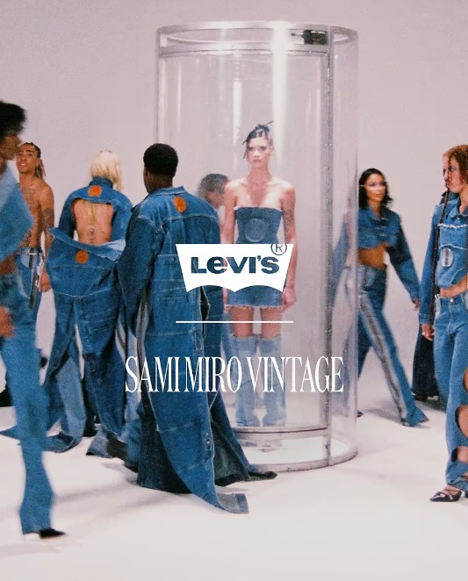
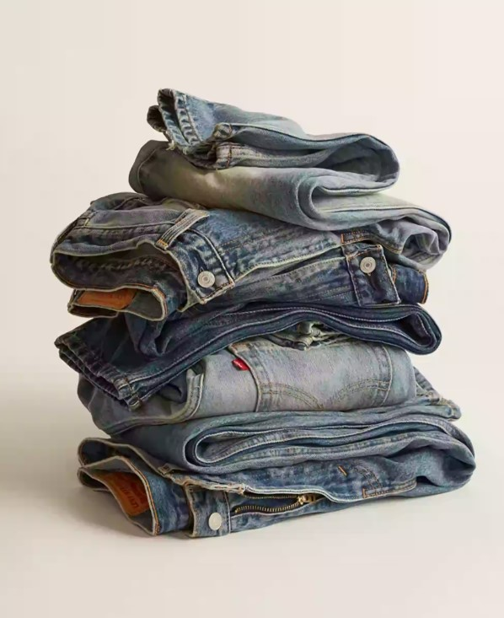
  SUMMARY
  CHALLENGES / PROBLEMS
  STRATEGY
  CONCLUSION
  LOOKING AHEAD
  QUESTIONS
  REFERENCES

Slide 4
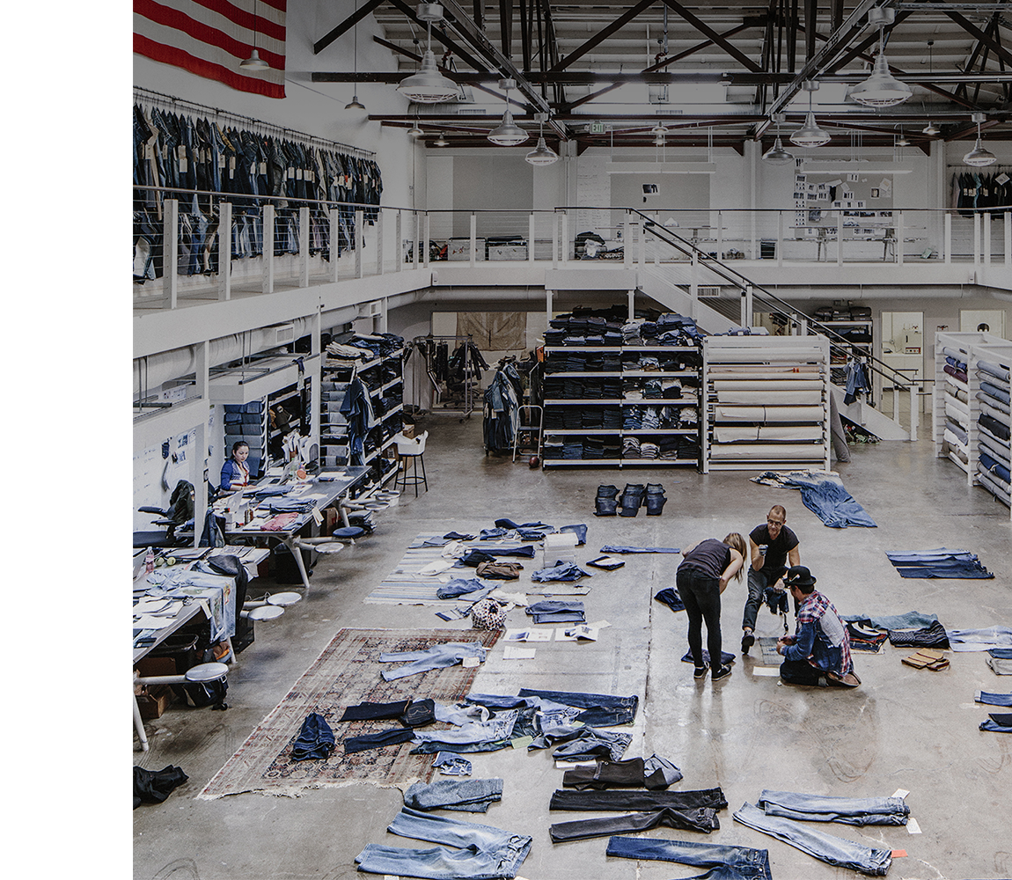
SUMMARY
Levi’s Strauss & Co, 169-year-old, family-controlled jeans maker has gone through various ownership structures and transactions (two IPOs and two leveraged buyouts).
Today, executives and most of its board of directors are from outside the family, but the founding family continues to control around 80 percent of shares.
Levi’s believed that a company defined by social values could be more financially successful than only caring about the bottom line.
It became the first corporation to warn investors that short-term profits might be limited by its long-term social responsibility goals.
LS & Co.’s put wide efforts to operate more responsibly and sustainably than its peers
In 1987, introduced a new mission statement, emphasizing ethics and open communication into employee performance reviews.
After the company developed water-reducing finishing techniques for denim in, it saved more than 3.5 billion liters of water.
It created digital laser finishing technology, which reduces the number of chemicals required,
It has developed technology that can reduce the need for physical product sampling.
SUMMARY
CHALLENGES/PROBLEMS
STRATEGY
CONCLUSION
LOOKING AHEAD
QUESTIONS
REFRENCES

Slide 5
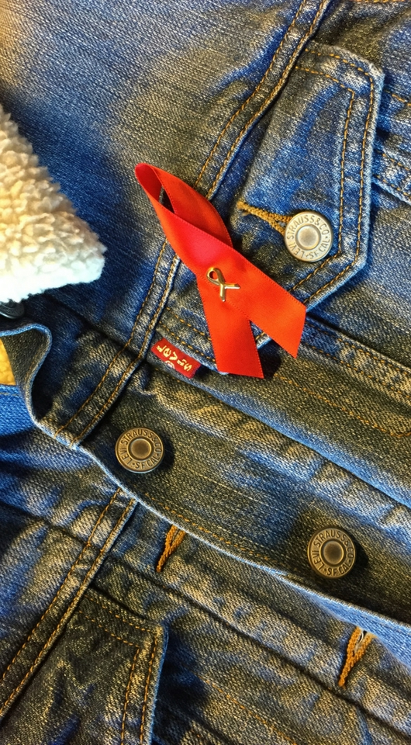
SUMMARY
Over the years, Levi’s made AIDS awareness, channeling its wealth into no fewer than five separate philanthropic multi-million-dollar foundations and “doing the right thing” has managed to endure throughout.
Levi’s has grown the company by investing internationally and introducing new business lines.
Levi’s jeans became the uniform of the countercultural figure, symbolizing both working class values and sexual freedom.
While competitors had already been making their products in Asia and Latin America for years after the NAFTA was signed in 1994, the brand had resisted the shift in order to try to preserve its American production roots.
In the late 1990s, LS & Co. underwent two major rounds of thousands of employee cuts. It closed its North American factories, and shifted production overseas, where labor was much cheaper, to better compete with brands like Gap and Tommy Hilfiger.
Tragedies including the Rana Plaza factory collapse documentaries like “The True Cost” raised awareness for consumers about the dangerous origins of their clothing and consumers are more concerned in shopping from brands that support fair trade policies.
SUMMARY
CHALLENGES/PROBLEMS
REFRENCES
Silk
STRATEGY
CONCLUSION
LOOKING AHEAD
Dupioni
QUESTIONS

Slide 6

SUMMARY
Over the last decades, LS & Co.:
LS & Co. was the first multinational company to announce a code of conduct for its contract suppliers and releasing their names
Publicly assessed its waste impact and made climate causes more of a priority.
Commissioned and published lifecycle assessment of a pair of jeans
Released specific targets for water recycling and reducing energy use.
Provided updates on how it is progressing.
Was one of the first companies to set science-based goals around reducing carbon emissions in response to the Paris Agreement.
Levi 's reached a major milestone in 2019 hadn’t seen since the 1980s by:
Seeing sustainability as a brand-defining differentiator in a competitive market.
Employing denim jackets analysts in trading floor, connecting Levi’s with a new, young generation of shoppers.
Cutting weak partnerships with department stores who sell Levi’s jeans.
Opening hundreds of stores in Europe while starting to tackle China.
SUMMARY
CHALLENGES/PROBLEMS
REFRENCES
Silk
STRATEGY
CONCLUSION
LOOKING AHEAD
Dupioni
QUESTIONS

Slide 7

SUMMARY
The global coronavirus pandemic shutdown:
Forced LS & Co. to close its stores in the US, Europe, and China
Forced LS & Co to Cut salaries
Forced LS & Co Furlough employees
Forced LS & Co to cancel future apparel orders
Forced LS & Co to borrow money to bolster its balance sheet.
Online sales were not making up the difference.
Levi’s has managed to weave higher priorities with its business by:
Better treatment for low-wage garment workers
Water conservation and energy- use reduction
Prioritizing cool and stylish design in Levi’s jeans for young shoppers.
SUMMARY
CHALLENGES/PROBLEMS
REFRENCES
Silk
STRATEGY
CONCLUSION
LOOKING AHEAD
Shantung
Dupioni
QUESTIONS

Slide 8
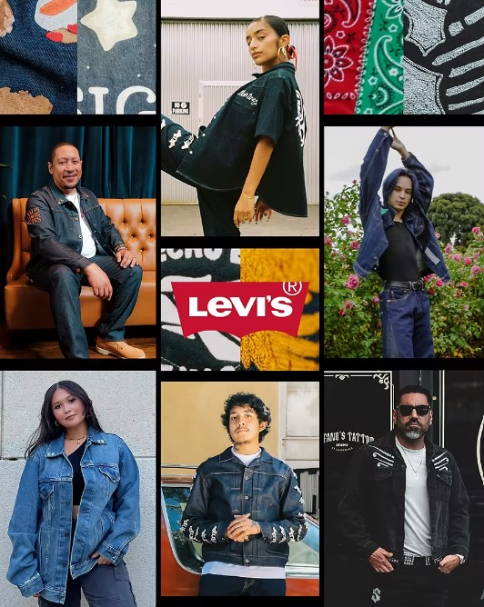
  SUMMARY
  CHALLENGES / PROBLEMS
  STRATEGY
  CONCLUSION
  LOOKING AHEAD
  QUESTIONS
  REFERENCES

Slide 9
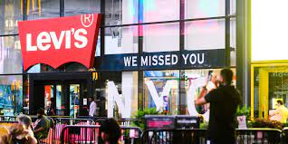
CHALLENGES / PROBLEMS
Before the Covid-19 pandemic, Levi’s goal was to reduce 90 percent of its carbon emissions and shift to using renewable energy sources like solar panels within its owned and operated facilities by 2025. They hoped to use organic cotton from farms, recycled cotton from suppliers, or the Better Cotton Initiative by 2020. However, since the Covid-19 pandemic, those plans has become unclear.
- The company's stock prices decreased by 24 percent
since it went public in March 2019.
Levi is facing environmental concerns about where to source their materials and products. There issue involve workforce management due to unemployment, pay cuts, and the disruption of their supply chain is due the Covid- 19 pandemic.
- Due to the influx of unemployment, 33.5 million, people filed for unemployment. As a result, there was a 30 percent decrease in revenue within the global fashion industry in 2020.
Due to the decrease in revenue, only a few brands were able to offset the decline with the use of their online retail platforms, but that only made-up 5 percent of Levi's total.
SUMMARY
CHALLENGES/PROBLEMS
REFRENCES
Introduction
Silk
STRATEGY
CONCLUSION
LOOKING AHEAD
Shantung
Dupioni
QUESTIONS

Slide 10
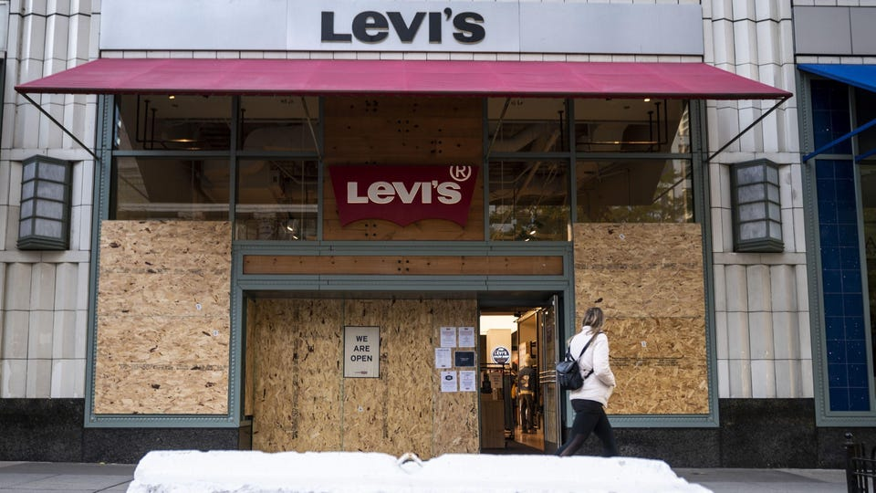
CHALLENGES / PROBLEMS
Levi's main markets (The United States and Europe) predicted that the online retail sale will decrease by 9 or 10 percent this year.
In addition to the effects of the Covid- 19 pandemic, Levi had to close their stores in the United Kingdom, U.S, France, and Germany.
In the first quarter of 2020, the company had to close its stores in China, and its revenue decreased in Asia to $20 million. Even though the stores in China reopened in mid-April, Europe and the U.S remained closed until mid-May due to the temporary closure. The company had to reduce employees' salaries at the store level, executive level, and within the board of directors.
“When the going gets tough, if you don’t have that moral compass, you will devolve to the quickest, most expedient solution, which may not be the right solution for the long term,”
SUMMARY
CHALLENGES/PROBLEMS
STRATEGY
REFRENCES
Introduction
Silk
CONCLUSION
LOOKING AHEAD
Dupioni
QUESTIONS

Slide 11

  SUMMARY
  CHALLENGES / PROBLEMS
  STRATEGY
  CONCLUSION
  LOOKING AHEAD
  QUESTIONS
  REFERENCES

Slide 12
STRATEGY
President and Chief Executive Officer Chip Bergh arrived in 2011
At this point, Levi’s had been struggling for the better part of two decades.
  Competitors were outgrowing the brand and department stores were struggling
  Revenue had declined from $6.8 billion in 1997 to $4.8 billion
In 2014, Bergh announced a new strategy that included:
  Laying off about 1,300 employees by removing layers of management and outsourcing some services including finance, human resources and customer service.
  The goal was to save $175 to $200 million in net annualized savings.
The Pandemic:
LS&Co. announced that all its stores in the US would close, the company furloughed 4,500 US retail employees and announced salary reductions for high-paid employees
Bergh and Singh decide how to shrink the business during this time, they will apply lessons from the way they approached reductions during the turnaround in 2014.
Communicating with employees over video meetings to allow them the chance to ask questions
SUMMARY
CHALLENGES/PROBLEMS
REFRENCES
Introduction
Silk
STRATEGY
CONCLUSION
LOOKING AHEAD
Shantung
Dupioni
QUESTIONS

Slide 13
STRATEGY
Crisis Management, the Levi’s Way:
In 2014, the LS&Co. strategy eliminated too many jobs, leaving employees stretched too thin
LS&Co. is paying suppliers for any products they have already made and shipped, as well as paying for any raw materials already sourced.
LS&Co. and the Levi Strauss Foundation announced a $3 million donation package as the first part of its Covid-19 charitable response, one third of which goes to communities around suppliers where garment workers, many now unemployed, who need food and medical care.
Invest in What Differentiates the Brand:
Bergh stated- “We’ve got to do what is right for the business for the long term.” And keeping its values in a crisis is part of a strategy of “doubling down on the things that makes us who we are.”
Strong commitment to the philanthropic passions of its founding family. The company is making efforts to reduce its harm to people and the environment will mean more to shoppers after the pandemic.
For example, Paul Dillinger, Levi’s head of global product innovation who oversees projects like the development of hemp as a cotton alternative.
Levi's has demonstrated a successful strategy. One that started back in 2014, to overcoming the pandemic in 2020, to keeping their brand values intact and learning from mistakes show that they care about who they work with, how they work, and their customers.
SUMMARY
CHALLENGES/PROBLEMS
REFRENCES
Introduction
Silk
LOOKING AHEAD
STRATEGY
CONCLUSION
Dupioni
QUESTIONS

Slide 14

  SUMMARY
  CHALLENGES / PROBLEMS
  STRATEGY
  CONCLUSION
  LOOKING AHEAD
  QUESTIONS
  REFERENCES

Slide 15
CONCLUSION
Levi Strauss & Co has been a family-owned company since 1853.
Throughout its history, there has been movement to become more sustainable, treat garment workers better, and alter the demographic to a younger generation.
The pandemic was a major setback for LS& Co., stores forced to close, employee furloughs, the company struggled to balance being a multi-billion-dollar company during the pandemic.
The company realizes it's not perfect and is starting to shift it's values to align with consumer wants and needs.
SUMMARY
CHALLENGES/PROBLEMS
REFRENCES
Introduction
Silk
STRATEGY
CONCLUSION
LOOKING AHEAD
Shantung
Dupioni
QUESTIONS

Slide 16

  SUMMARY
  CHALLENGES / PROBLEMS
  STRATEGY
  CONCLUSION
  LOOKING AHEAD
  QUESTIONS
  REFERENCES

Slide 17
LOOKING AHEAD
As part of the reopening process in the US, Levi and Co said that in addition to new safety regulations for the shop and associates, company will offer paid sick leave
Company will need to reckon with prolonged store closures, recession will cut consumer spending for years
"'These are moments for us to pressure test our values'' -Daniel Lee executive director of Levi Strauss Foundation
Still unclear just how bad the pandemic will be for non-essential consumer brands
SUMMARY
CHALLENGES/PROBLEMS
STRATEGY
CONCLUSION
LOOKING AHEAD
QUESTIONS
REFRENCES

Slide 18
LOOKING AHEAD
''We are going to be a smaller company at the end of this,'' -Bergh
Committed to sticking to the LS &Co.'s long-term goals, continuing to hit climate targets and investing in supporting garment workers
Bain & Company predicts consumers will come out of the pandemic with a greater appreciated for brands that reflect their own values.
LS &Co. Has been trying to expand its margin to have a wide range that can appeal to shoppers who will have less money to spend on jeans
SUMMARY
CHALLENGES/PROBLEMS
STRATEGY
CONCLUSION
LOOKING AHEAD
QUESTIONS
REFRENCES

Slide 19
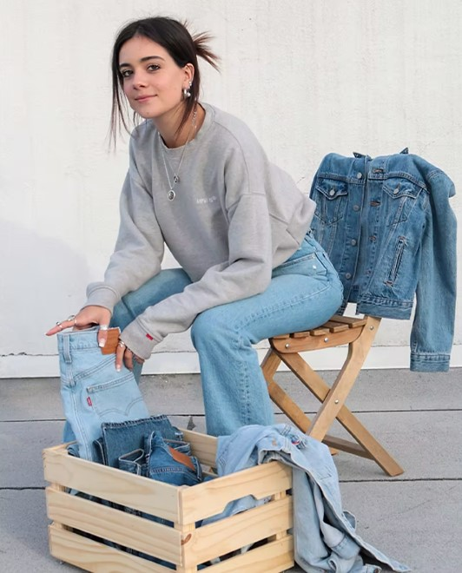
  SUMMARY
  CHALLENGES / PROBLEMS
  STRATEGY
  CONCLUSION
  LOOKING AHEAD
  QUESTIONS
  REFERENCES

Slide 20
QUESTION 1
Which of the following is Not discussed as Levi’s achievements?
Water-reducing finishing techniques
Laser finishing technology
Reducing the need for physical product sampling
Incorporating TOUGH COTTON technology
SUMMARY
CHALLENGES/PROBLEMS
STRATEGY
CONCLUSION
LOOKING AHEAD
QUESTIONS
REFRENCES

Slide 21
QUESTION 1
Which of the following is Not discussed as Levi’s achievements?
Water-reducing finishing techniques
Laser finishing technology
Reducing the need for physical product sampling
Incorporating TOUGH COTTON technology
SUMMARY
CHALLENGES/PROBLEMS
STRATEGY
CONCLUSION
LOOKING AHEAD
QUESTIONS
REFRENCES

Slide 22
QUESTION 2
In 2014, Bergh announced a new strategy that included how many employee layoffs?
A. 1,500
B. 1,850
C. 1,300
D. 2,000
SUMMARY
CHALLENGES/PROBLEMS
STRATEGY
CONCLUSION
LOOKING AHEAD
QUESTIONS
REFRENCES

Slide 23
QUESTION 2
In 2014, Bergh announced a new strategy that included how many employee layoffs?
A. 1,500
B. 1,850
C. 1,300
D. 2,000
SUMMARY
CHALLENGES/PROBLEMS
STRATEGY
CONCLUSION
LOOKING AHEAD
QUESTIONS
REFRENCES

Slide 24
QUESTION 3
In 2020, where did Levi’s have to close their stores?
A. Europe, China, Canada, United Kingdom
B. Australia, United States, China, Brazil
C. Europe, United States, Korea, Germany
D. Germany, France, United Kingdom, United States
SUMMARY
CHALLENGES/PROBLEMS
STRATEGY
CONCLUSION
LOOKING AHEAD
QUESTIONS
REFRENCES

Slide 25
QUESTION 3
In 2020, where did Levi’s have to close their stores?
A. Europe, China, Canada, United Kingdom
B. Australia, United States, China, Brazil
C. Europe, United States, Korea, Germany
D. Germany, France, United Kingdom, United States
SUMMARY
CHALLENGES/PROBLEMS
STRATEGY
CONCLUSION
LOOKING AHEAD
QUESTIONS
REFRENCES

Slide 26
QUESTION 4
As a part of the reopening process, what did LS& Co. Incorporate into their new plan?
A. New safety guidelines for shops and sales associates
B. Paid sick leave to all part-time retail employees
C. Two free at-home Covid tests per month
D. Increasing payroll for employees
SUMMARY
CHALLENGES/PROBLEMS
CONCLUSION
QUESTIONS
Introduction
Silk
STRATEGY
Dupioni
REFRENCES
LOOKING AHEAD

Slide 27
QUESTION 4
As a part of the reopening process, what did LS& Co. Incorporate into their new plan?
A. New safety guidelines for shops and sales associates
B. Paid sick leave to all part-time retail employees
C. Two free at-home Covid tests per month
D. Increasing payroll for employees
SUMMARY
CHALLENGES/PROBLEMS
STRATEGY
CONCLUSION
LOOKING AHEAD
QUESTIONS
REFRENCES

Slide 28

  SUMMARY
  CHALLENGES / PROBLEMS
  STRATEGY
  CONCLUSION
  LOOKING AHEAD
  QUESTIONS
  REFERENCES

Slide 29
REFERENCES
Fernandez, C. (2020). How Levi's is navigating the purpose and profit trade-off. BoF Education. Retrieved 2022, from https://courses.businessoffashion.com/courses/case-study-levis-sustainability-responsible-business
Levi.com. (2022). Retrieved 2022, from https://www.levi.com/US/en_US/
SUMMARY
CHALLENGES/PROBLEMS
REFRENCES
Introduction
Silk
STRATEGY
CONCLUSION
LOOKING AHEAD
Dupioni
QUESTIONS

Slide 30
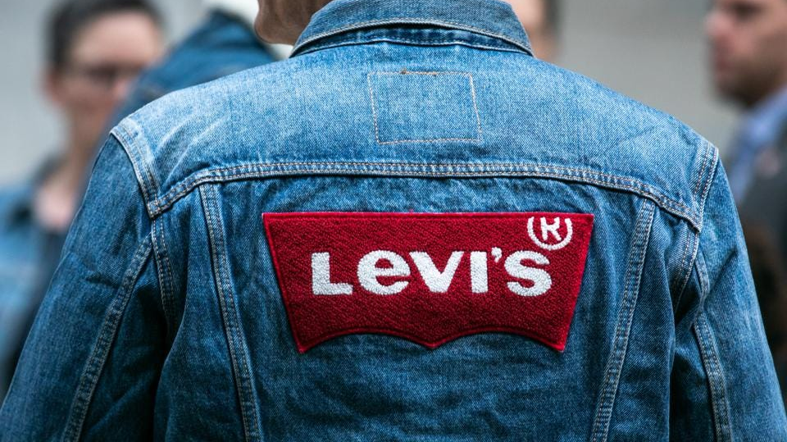
Thank you for your attention!

